Slide 1
Notes:
In 2019 we our club had 33 members. We adopted Domestic and Family Violence as our core project or campaign in that year. The campaign was so successful that we did it for a second year. Over these 2 years our club grew to 76. This campaign has now been running nearly 6 years and our club had 88 members in June this year.

Slide 2
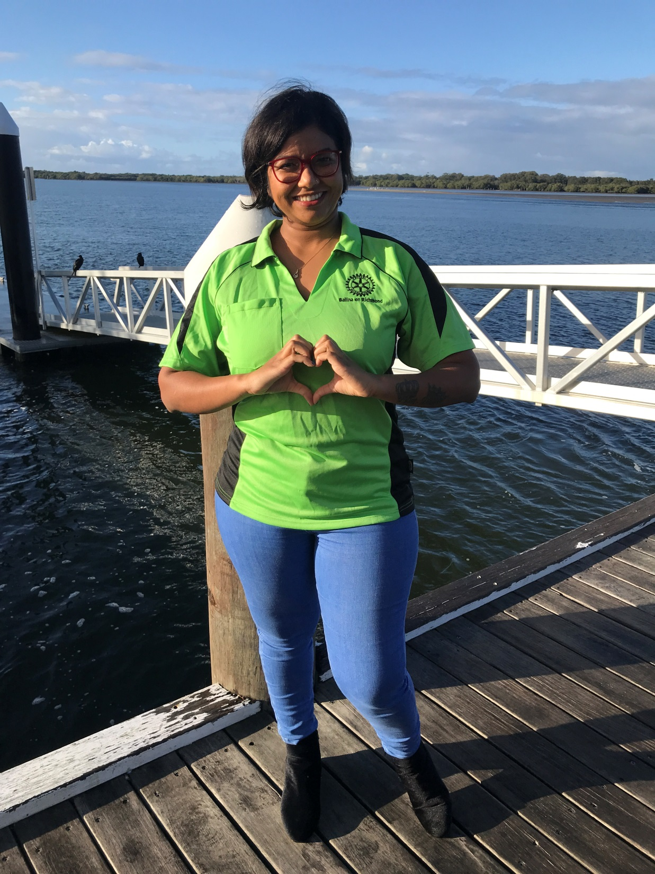
What is Your Club’s ‘Core Business’? What can your club offer to a potential member?
What service and activities are you passionate about?
Passionate Volunteers are your Club’s most Valuable Asset
Notes:
Ask them! Encourage them to pursue this!

Slide 3
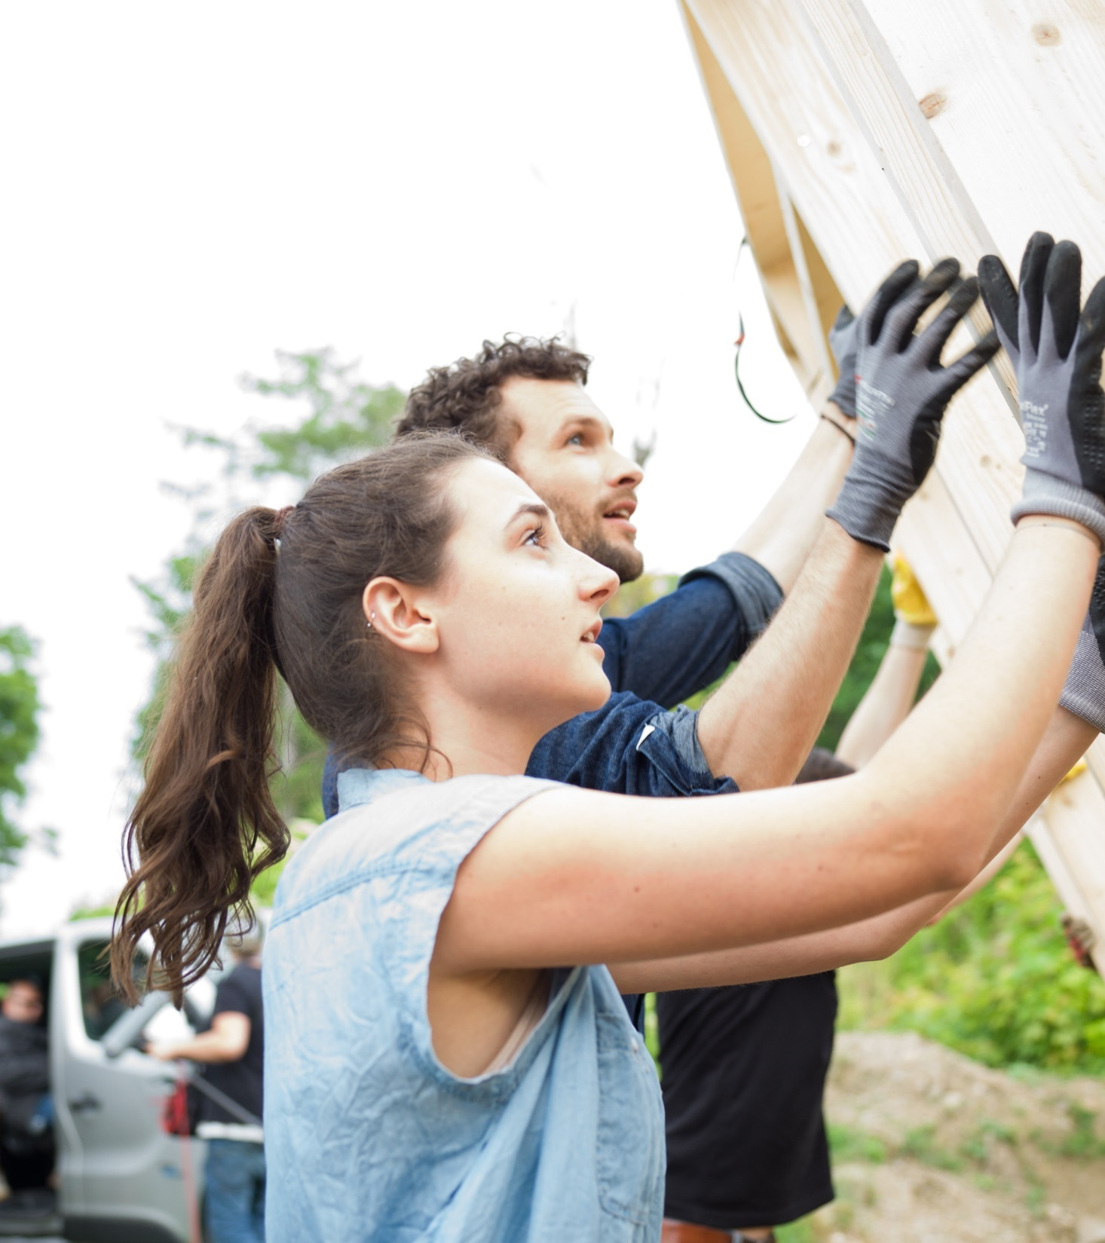
What do Members Want?
Friendship
Community Service
Personal Development
Notes:
A recent RI survey noted the 3 areas of focus that current and future members are looking for. We have a history of being very good at raising money for causes and then donating the funds for the recipient that will often receive all the media and community recognition. Why don’t we look at finding a cause or project that we can undertake ourselves. Raise funds and make a difference

Slide 4
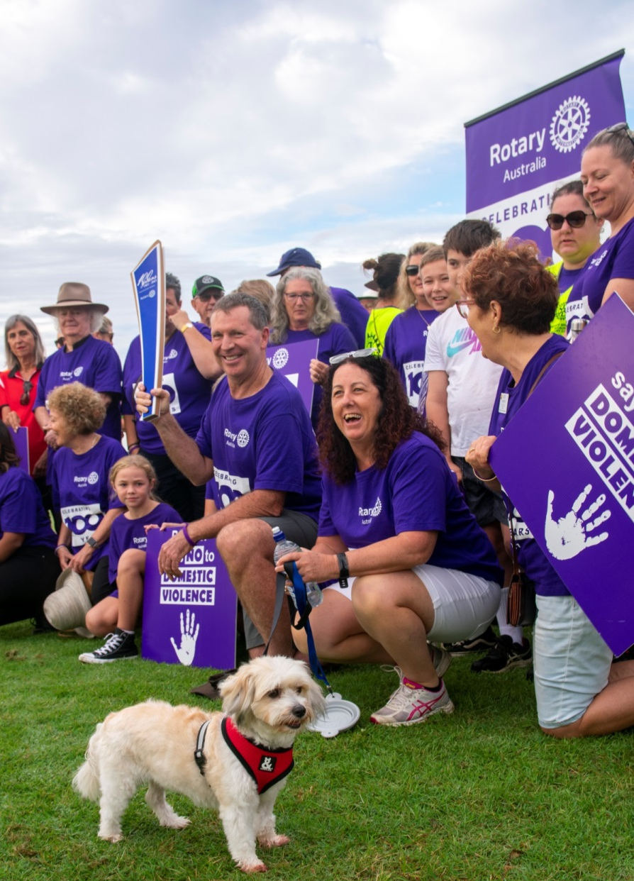
It always seems impossible until it's done.
- Nelson Mandela
Established “Core Business Objectives”
FOCUS ON LOCAL CAUSES
ENGAGE COMMUNITY
ATTRACTIVE & RELEVANT CLUB
ENGAGING EDUCATIONAL MEETINGS
STRONG COMMUNITY PROFILE
USE FACEBOOK & INSTAGRAM
80% EFFORT TO CORE OBJECTIVES
Notes:
In 2019 our club decided to take a different direction. For many years we were a fundraising club. We decided to connect more with community on social justice causes such as Mental Health, Homelessness and Domestic and Family Violence. Domestic and Family violence was the cause that immediately gained the attention of our community and so began our campaign of Rotary Says NO to Domestic and Family Violence. As the incoming President of our club Dave Harmon set his plan for the following 2 years based on the Core Objectives noted.
Projects/Projects/Projects=Service/Service/Service Apex No.1 Ideal was ‘Make Service the Basis of all Enterprise’ Rotary has 5 Avenues of Service, Club Service, Vocational Service, Community Service, International Service and New Generation Service.
Rotary Brand is easy to sell like Toyota/Honda, trusted reliable. How do you sell your brand to your community. You need to connect with your town with a project or projects that have purpose, meaning and make a difference. Then you need to sell it.

Slide 5
Integrity
Making a difference and contributing to causes and needs both locally and globally.
Golf Day
Fellowship
DIK
RAWCS Re-cycle Reuse
Gala Dinner
Breakfast
Club
Homeless
Hot Meal
Centre
Domestic Violence Advocacy and Education
Love Bites Education Program
Youth
Programs
Bowls Day
Service
Polio Plus Rotary Foundation
Day’s for Girls Birthing Kits
Flood Support
Employee
Recognition
Mental Health
Duck Race
Diversity
Richmond Room/Sign
Leadership
Notes:
It is critical that we always have Rotary’s Core Values front in our mind. Noted is our values, some of the fund raisers our club conducts and the inner cercles displaying our principal service projects. You will note that D&FV is the centre of our core business

Slide 6
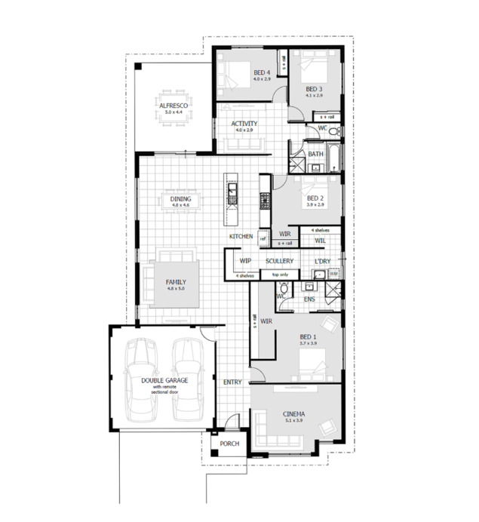
WOULD YOU BUILD A HOUSE WITHOUT A PLAN?
HAS YOUR CLUBS STRATEGIC PLAN WORKED FOR THE CLUB?

Slide 7
DAVE’S 4 STRATEGIC R s TO GROW ROTARY
Renewal Re-Growth Retention Relevance
Notes:
Our clubs need to have member renewal, new members bring new ideas and enthusiasm. We need Re-Growth, existing members can become stayed in their ways, inflexible. As leaders in our clubs we need to engage these members, show them the value of new ideas and projects.
To have a good retention of members we need to look no further than our 5 core values, if a club has Friendship high on its priorities, has integrity as a club, is diverse and represents the community you serve, projects and service will happen organically

Slide 8
Notes:
In the years 2019 – 2020, 2020-2021 our club grew from 33 to 76 members. In June this year we had 88 members. Over the past 5 years we have a member retention of over 90%, new member retention of 99% and a club gender balance of 48%women.

Slide 9
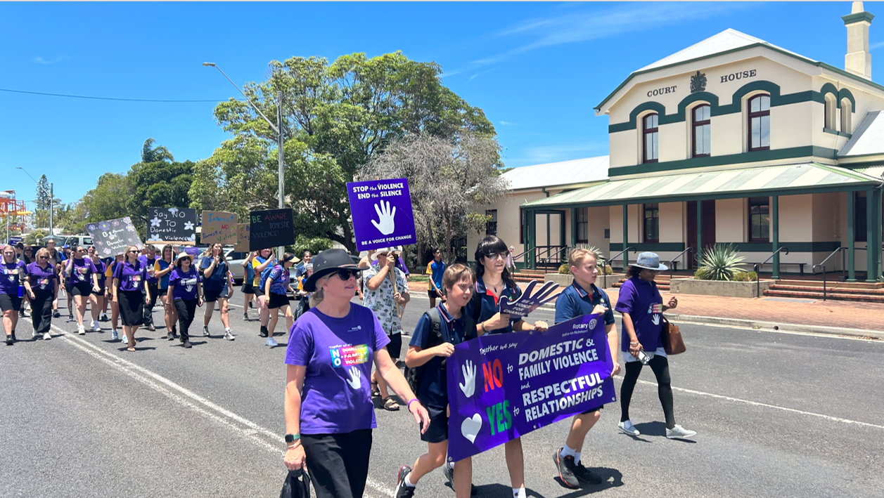
Notes:
We connected with a cause that is of major concern in every town and city in our Rotary zone and more widely in the world. We encourage you to connect with relevant stakeholders in your community, form partnerships, let your community know what you are doing, build your profile.

Slide 10
Notes:
We connected with a cause that is regarded as the NO.1 social scourge in our society. We built our relevance and identity in our town. We formed many partnerships with government and no-government agencies. We told our story through all media

Slide 11
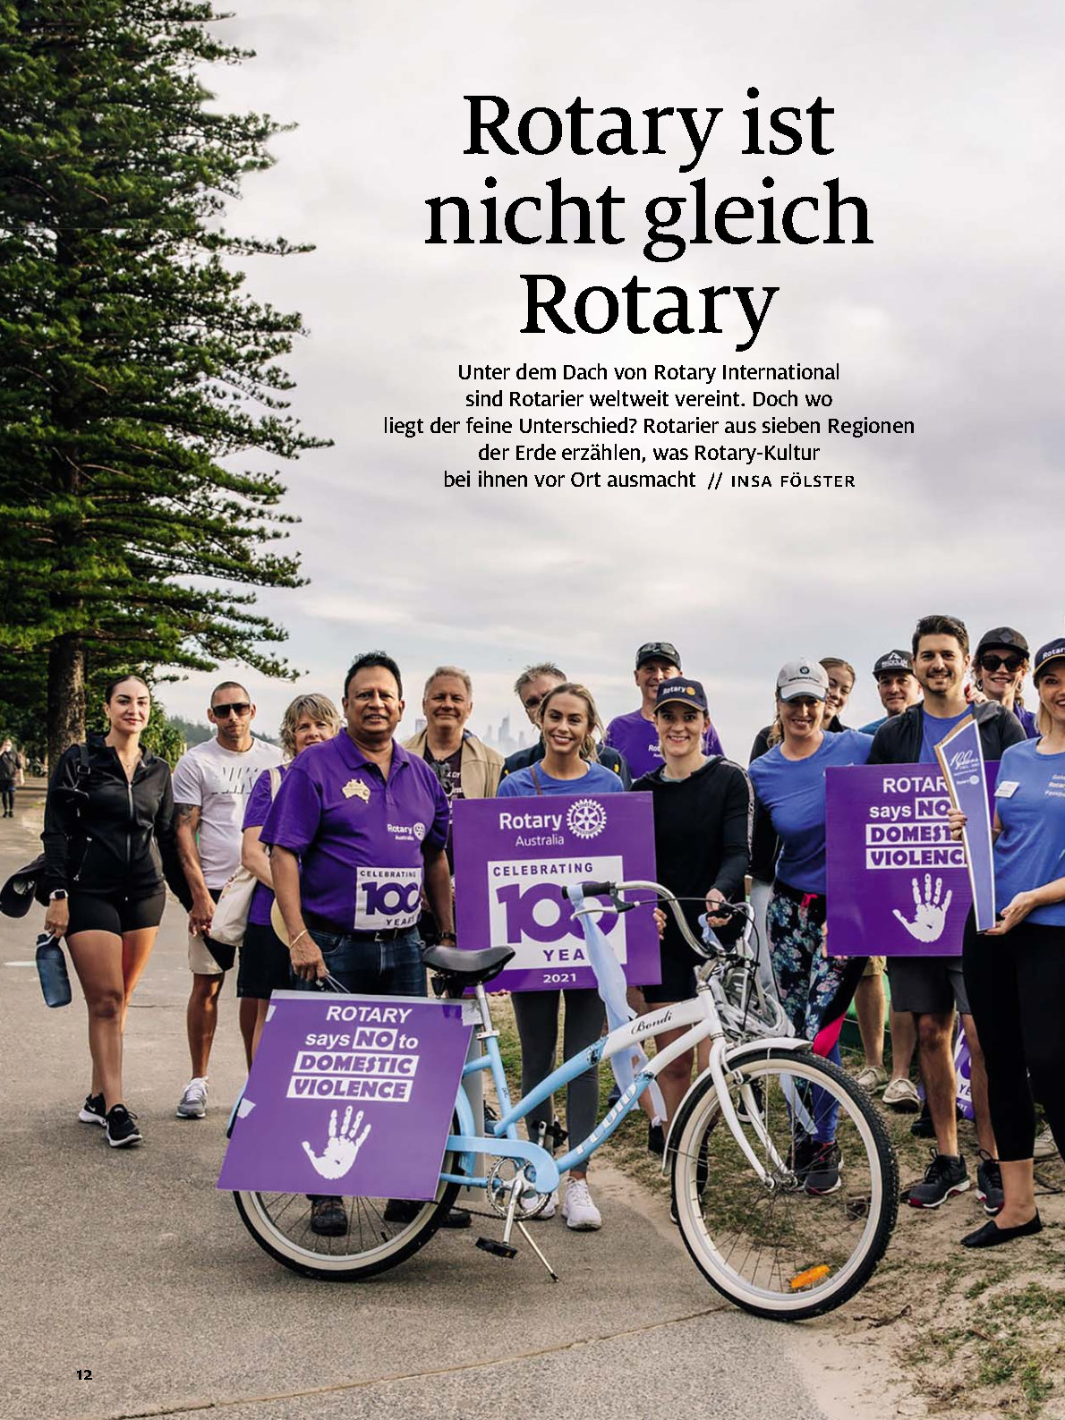
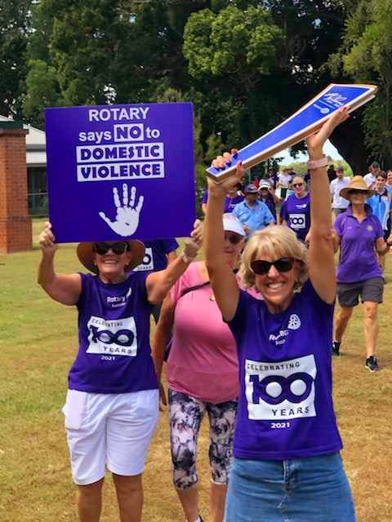
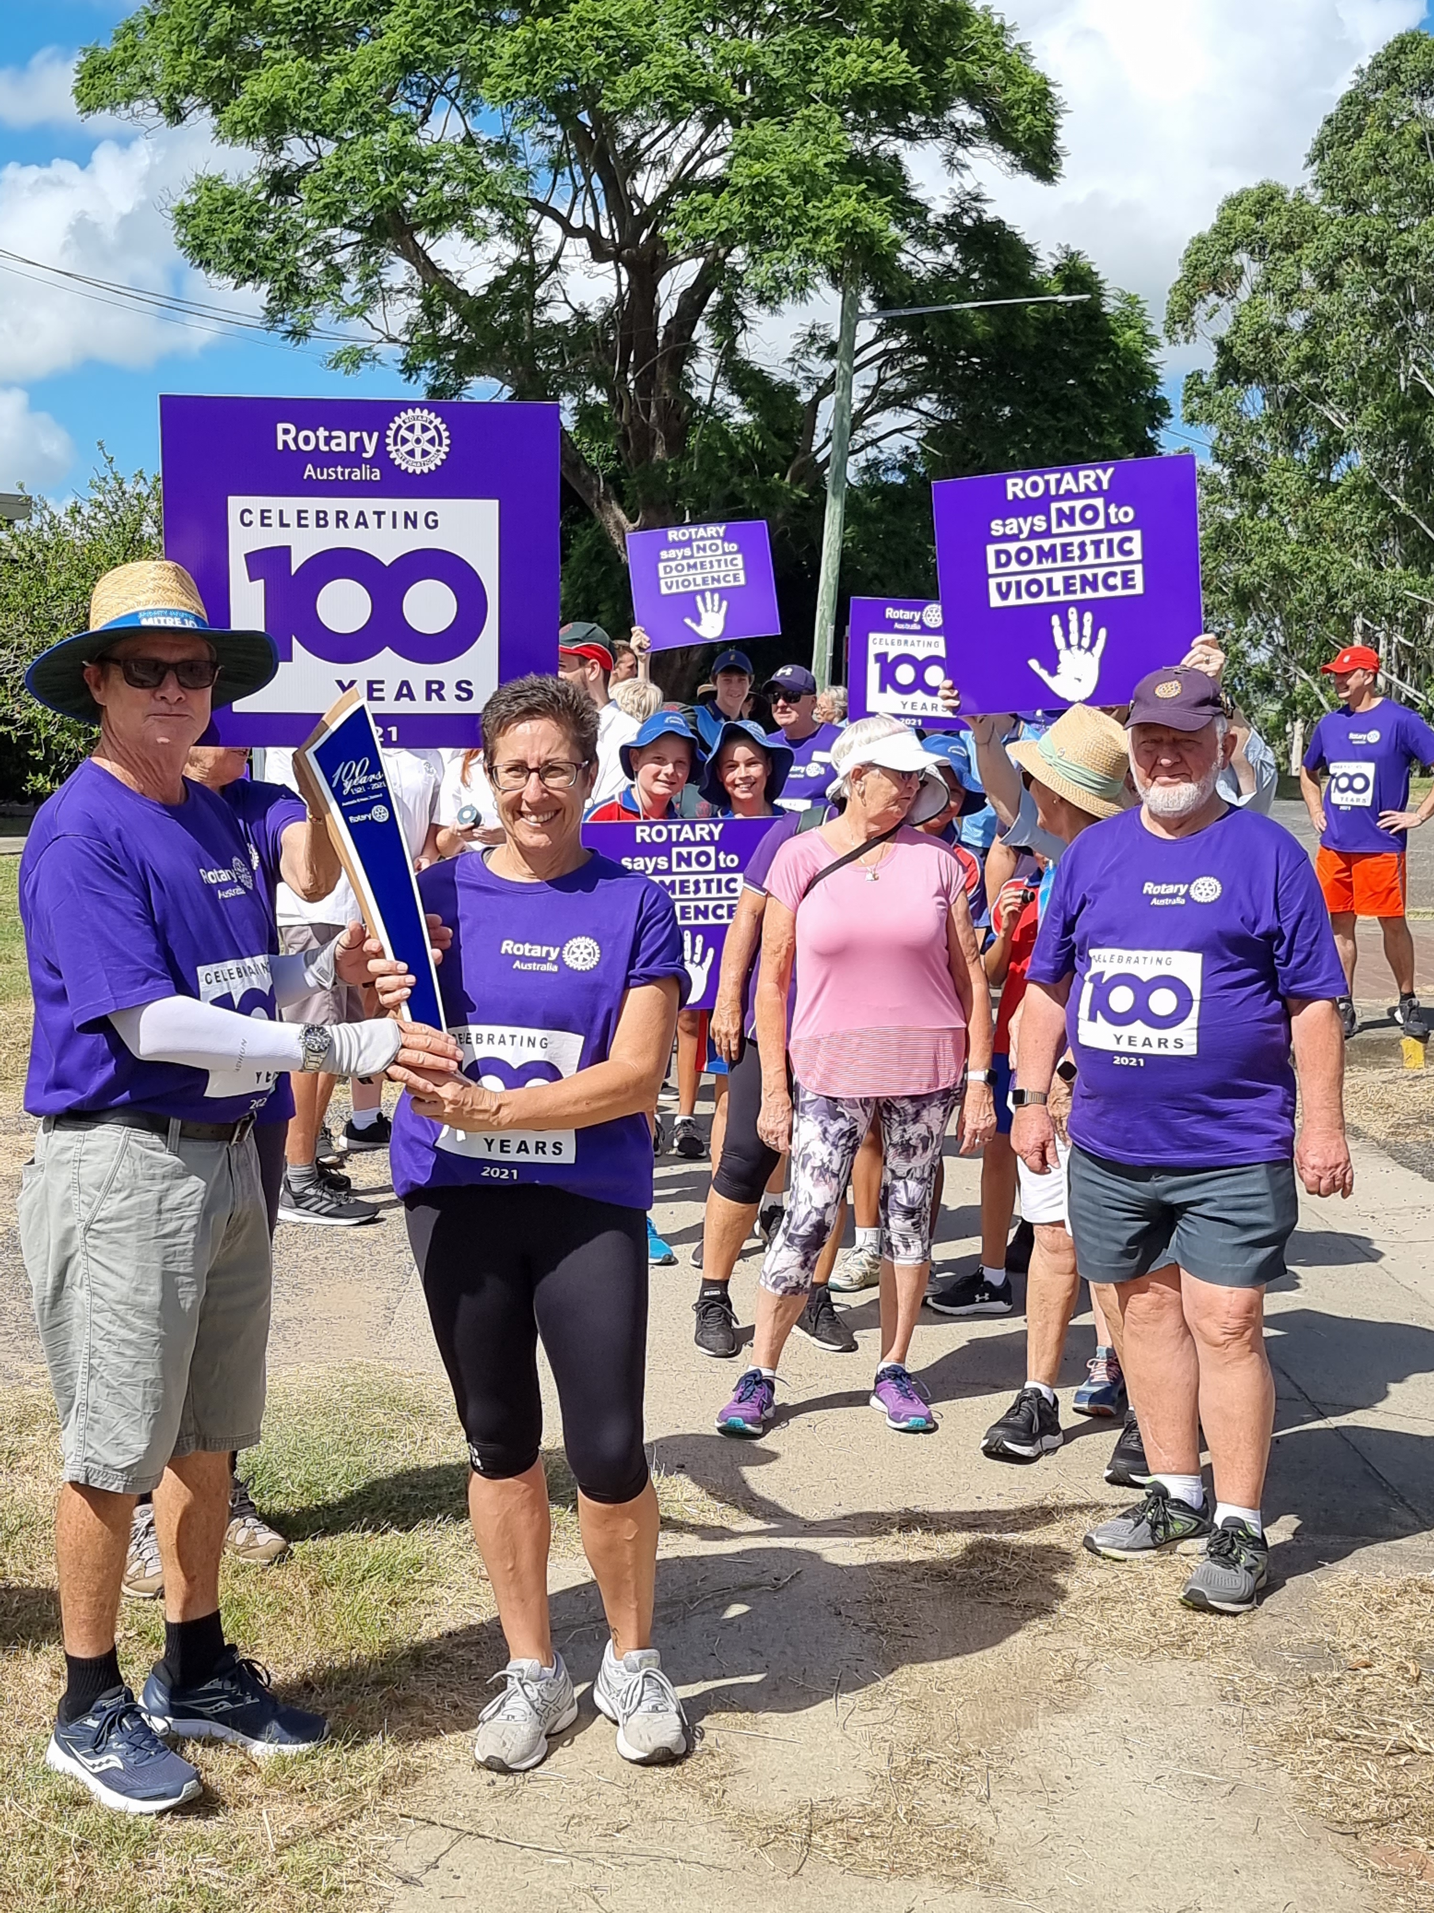
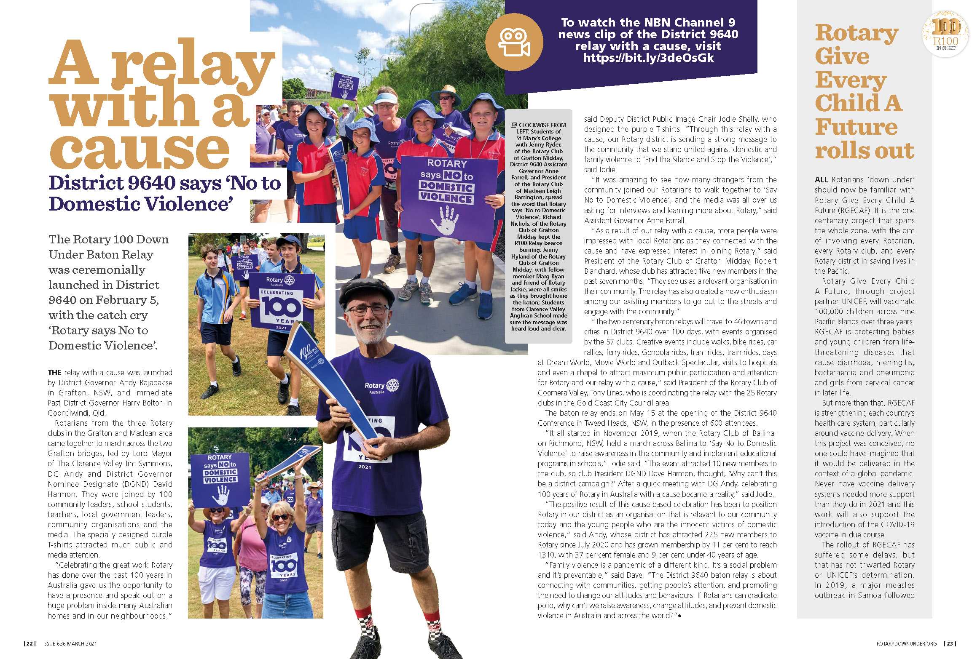
KEY STRATEGY - ENGAGING COMMUNITY & MEDIA
Notes:
We upscaled our media profile. We commenced regular radio interviews, built our social media platform and promoted our cause through relevant news outlets.

Slide 12
Notes:
Having an Engineering background I relate having a successful project or campaign to my formula; it does not matter what type of club you are, if you find a cause that connects with your demographic you will have relevance in your town or city. If you have relevance you have an identity. If you have an identity you have something to market and something many residents will want

Slide 13
CAN WE REINVENT YOUR CLUB?

