Slide 1
Domestic and Family
Violence Project
We have a 2 stage approach to DV
1. Raise awareness & advocate against DV
2. Educate Youth about Respectful Relationships
Notes:
Many Rotary clubs already active in supporting the cause of Domestic Violence. We encourage clubs that are to continue with their great work. This may include providing support for those experiencing of fleeing domestic and family violence. This campaign is directly linked to the federal governments ‘stop it at the start campaign’ after much consultation with both government and non-government agencies it was widely agreed that Rotary could best make a positive impact in the area of D&FV by Raising Awareness and advocating against D&FV and providing support with the delivery of Respectful Relationship programs is schools such as the ‘Love Bites’ program. NAPCAN (National association for the Prevention of Childhood Abuse and Neglect) has partnered with Rotary to help influence positive change in attitudes and behaviours that support gender based violence. This is a primary prevention approach

Slide 2
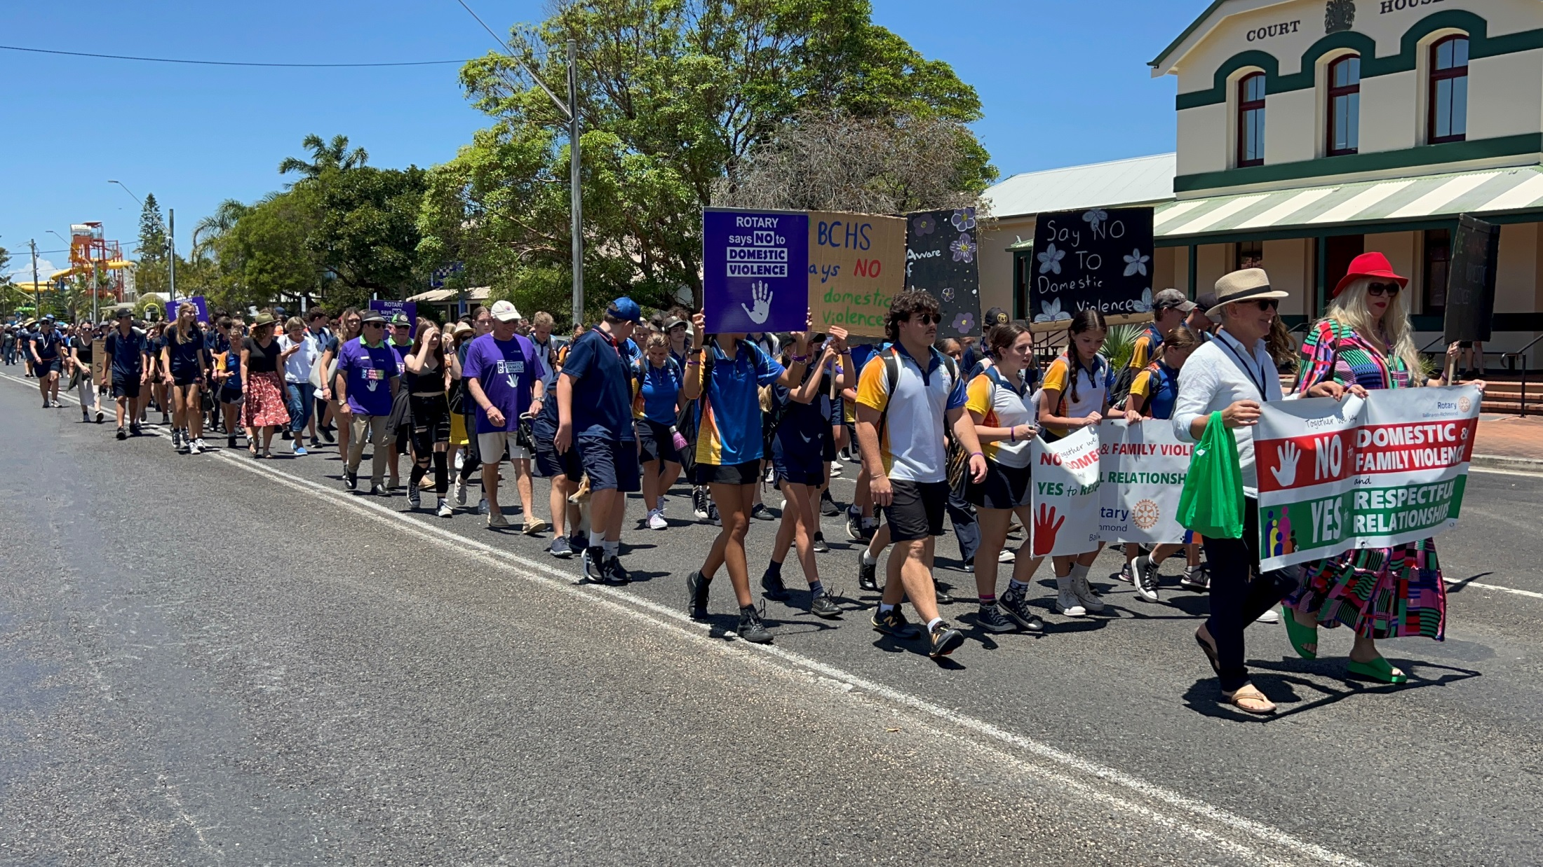
My Story in ‘Creating Hope in the World’
Notes:
In 2018 I (Dave Harmon) attended a funeral service for a friends sister that was stabbed to death in front of her 3 young children and the house set on fire. At this time I was the incoming president of the Rotary club of Ballina on Richmond and I remember thinking to myself at the funeral ‘this is just crazy what is happening with regard to D&FV and what could I do as incoming president of our club to make our town a safer place for women and children?’
I discussed this with our new club board and we began our project/campaign against D&FV

Slide 3
Where do you Start?
Consult your community. Undertake a community assessment.
Is there a community group or organisation in your town that already organisers events for this cause? If so why not collaborate and partner with them?
In Ballina there was inaction around advocacy and raising community awareness of Domestic and Family Violence.
Notes:
My wife Robyn and I spent a couple of months meeting with various stakeholders that work in or support D&FV. From these discussions it was concluded that we hold our first community walk against D&FV in November 2019

Slide 4
What did we do?
We began knocking on doors. Talked and had conversations with professional & volunteers that work in the area of DV.
What did they think we could do to help?
We formed relationships with:
Police, Health, Local Primary and High Schools, Local Council,
Service Providers, Women's Groups like Zonta, CWA, Inner Wheel,
Local DV committees, State and Federal Members,
Salvation Army, St Vincent De Paul and more.
Notes:
Please refer to the Tool Kit for support material

Slide 6
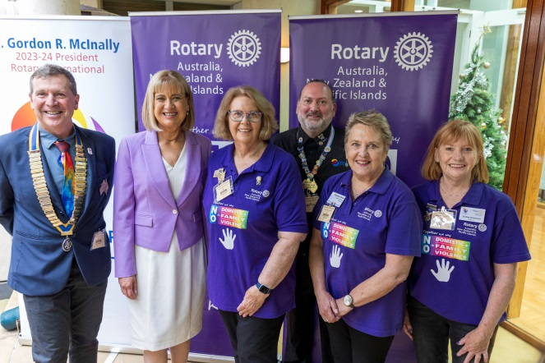
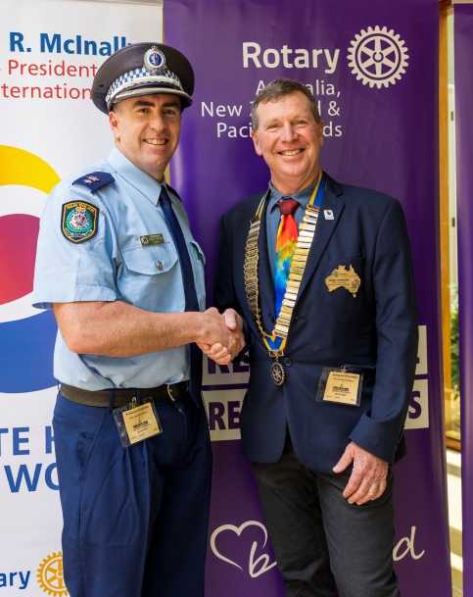
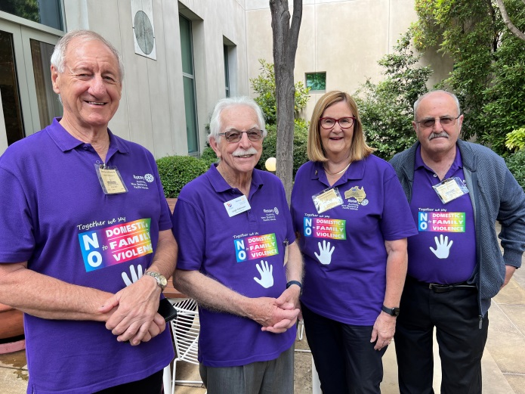
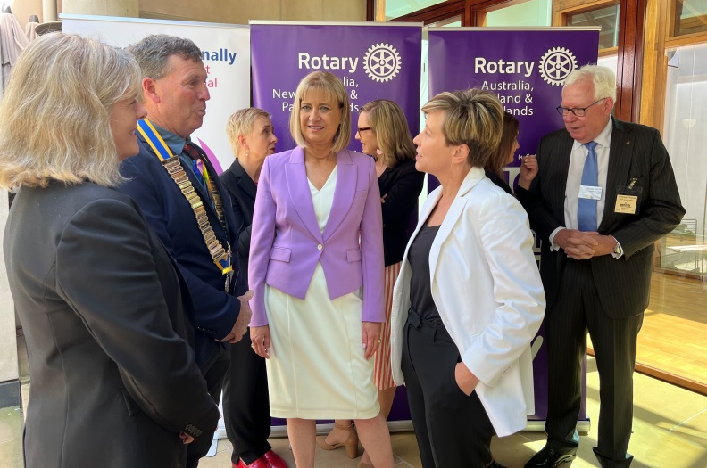
Launch at Parliament House
Canberra
Notes:
In November last year Rotary launched this campaign at Parliament House Canberra. This campaign has Tri-partisan support, is supported by the commonwealth D&FV Commissioner and has formed partnerships both state wide and nationally. This is the first time in Australia that Rotary has launched a campaign in the national capital.

Slide 7
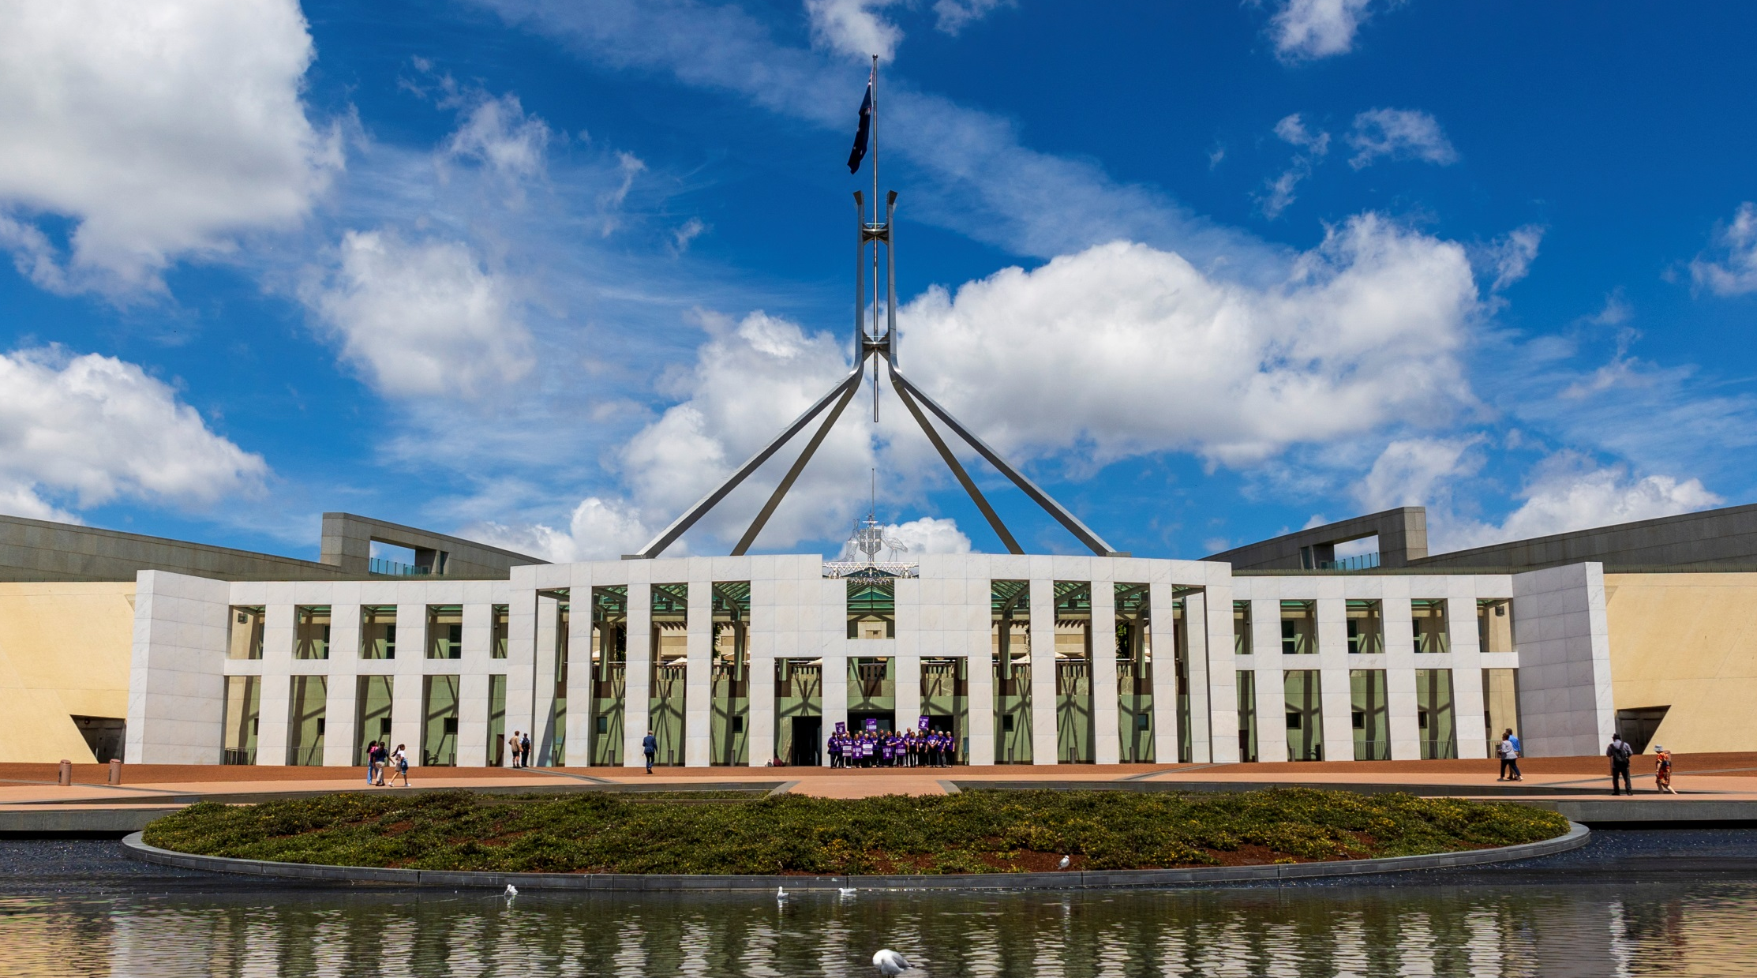
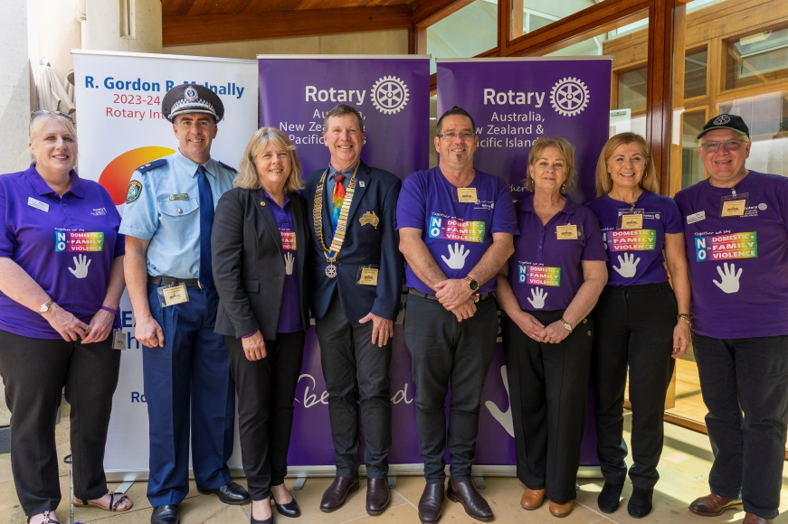
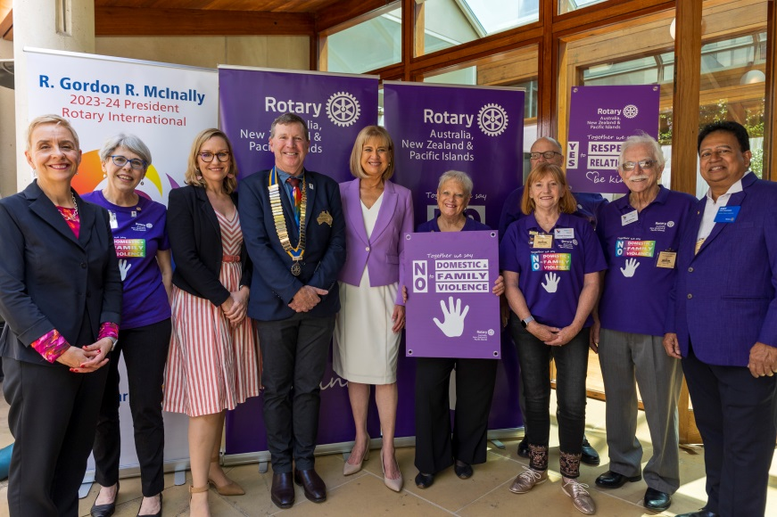

Slide 8
Notes:
We have both formal and informal partnerships formed with various state Police. In NSW we have a 3 year partnership with the NSW Police force. This is the result of the relationship formed with our local superintendent Mr Scott Tanner who has worked very closely with our Rotary clubs campaign. Mr Tanner invited me to attend Police Head office in Sydney and present a partnership proposal to NSW Police. This proposal was unanimously supported. This partnership main area of focus is for both parties to combine our resources and activate an activity during the international 16 days of activism against gender based violence from 25 Nov – 10th Dec. This photo shows the signage we have at the front entrance of Ballina Police station during the 16days of activism

Slide 9
Notes:
Our Rotary approved Purple Shirts are wearable advocacy

Slide 10
Notes:
Our Ballina walk down the main street last year

Slide 12
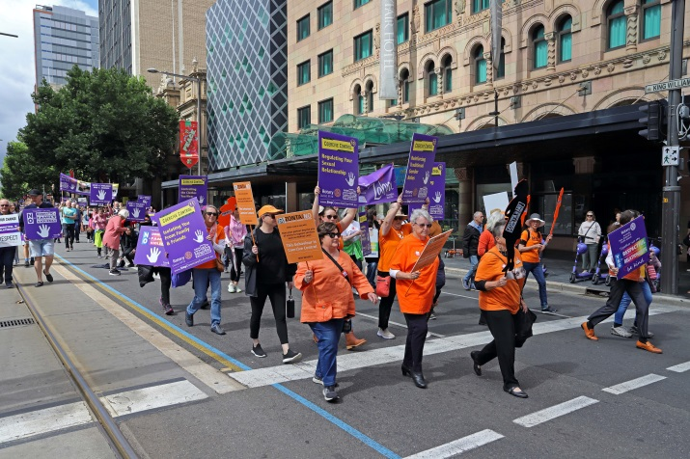
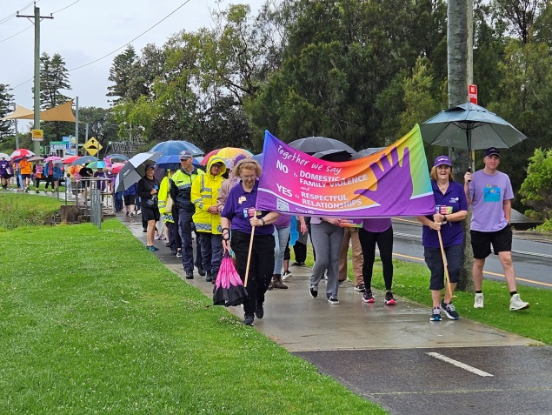
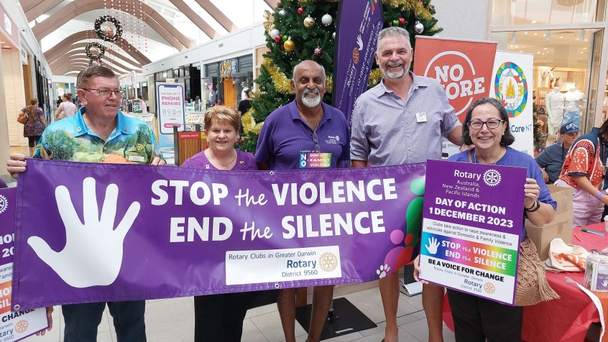
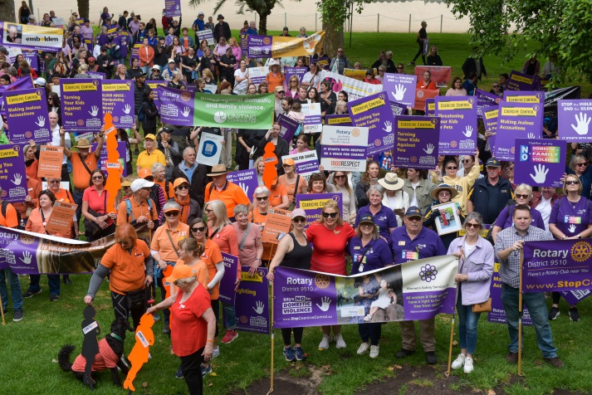
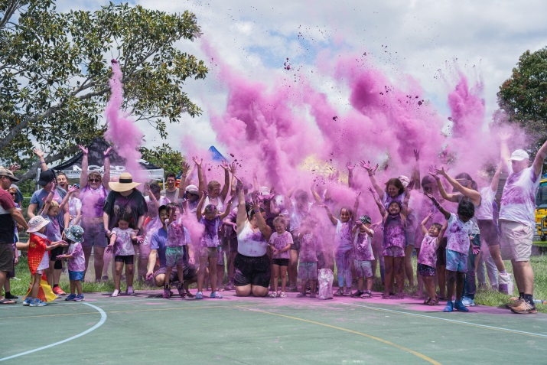
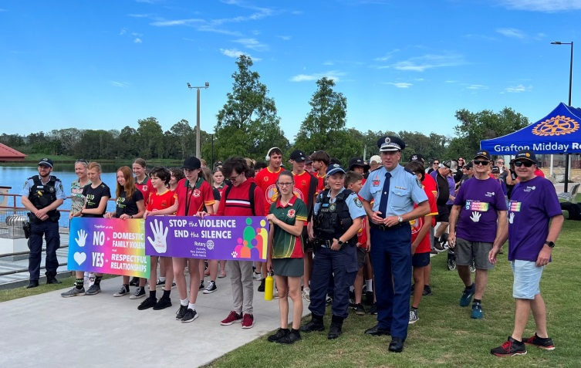
ZONE 8 Domestic & Family Violence Events Nov-Dec 2023
Notes:
Last year during the 16 days of activism we had Rotary clubs involved in or organised 110 activities around Australia. Photos show Brisbane, Adelaide, Wollongong, Darwin, Gold Coast and Grafton

Slide 13
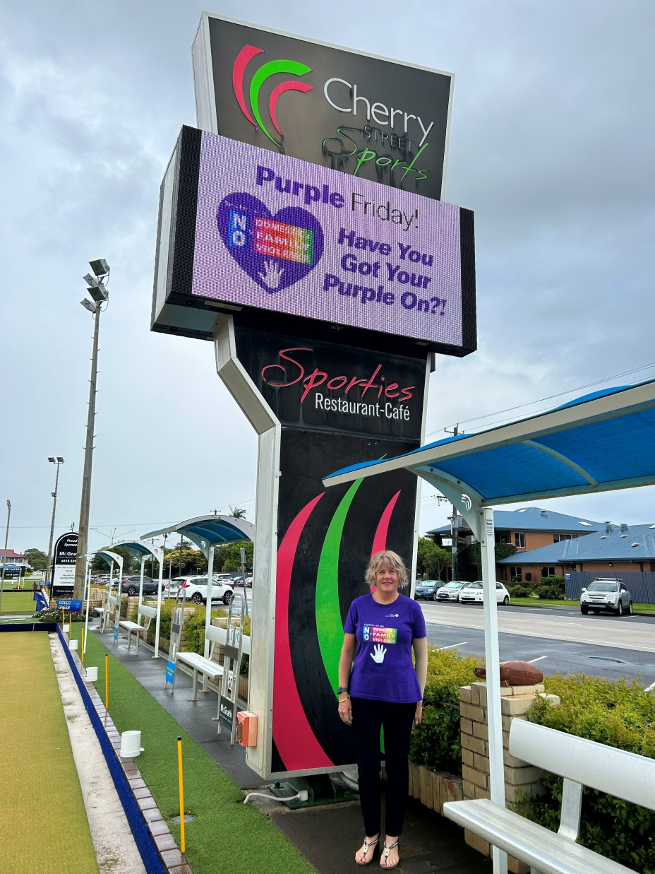
Purple Friday
Over 90 Businesses wearing dual branded shirts
every Friday.
Including;
Ballina Council
Ballina Primary & Secondary Schools, Day Care Centres
Registered Clubs on Northern Rivers
Retail Shops – Best & Less, IGA, Foodworks
Hospitality, Motels, Ramada
Professional Offices, lawyers,
Various Trades
Creating Impact
Increasing our Relevance
Confirming our Identity
Notes:
Purple Friday has helped lift this campaign to the next level. During the Christmas New Year period of 2022 a local Licenced Sports club ‘Cherry St Sports’ asked our Rotary club is their staff could wear our Rotary branded Purple Shirts over the Christmas New year period to help raise awareness of D&FV. Unfortunately on the 1sr of January 2023 Ballina had the first D&FV related death and the community very much come together with their grief and disbelief of this happening in our CBD. Our Rotary club and the management of the Sports club then met and we discussed what we could do to raise more awareness, let those experiencing D&FV know that they are supported and believed. We began a social media blitz offering 1000 free shirts to local businesses that would like to be part of our Purple Friday Campaign (each business would wear these shirts every Friday) In 2 weeks we had 80 businesses sign up, we now have close to 100 businesses which includes our local High School with 80 staff and 2 Primary Schools. This is Public Image, Impact and community engagement at its best. Our Rotary club now helps subsidise shirts for new businesses that wish to participate.

Slide 14
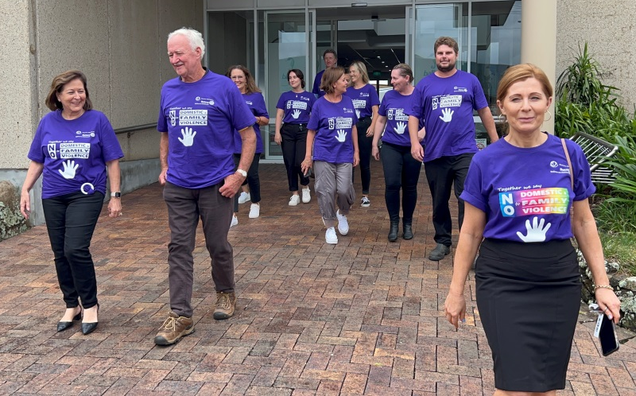
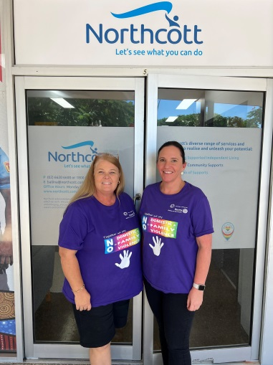
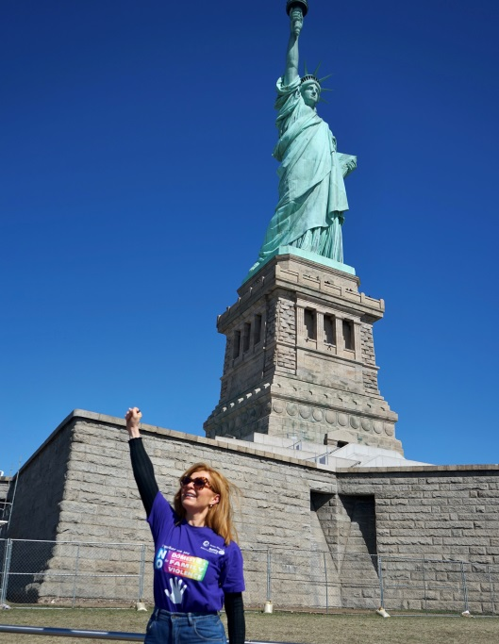
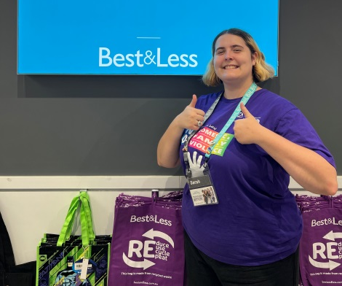
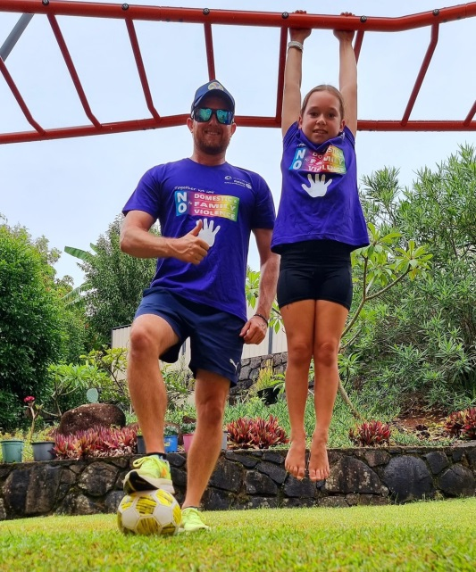
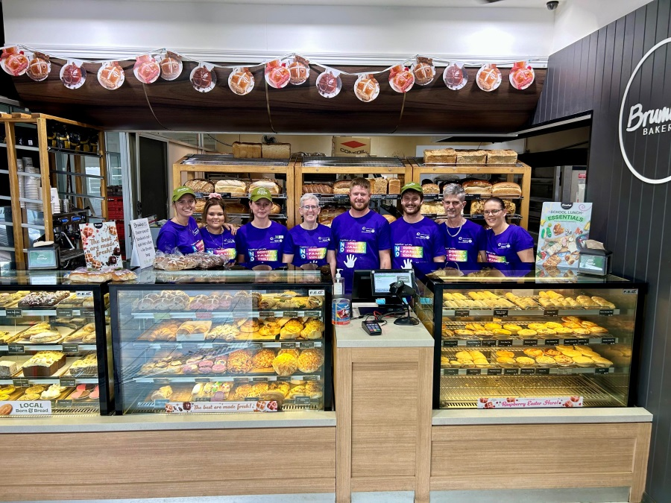
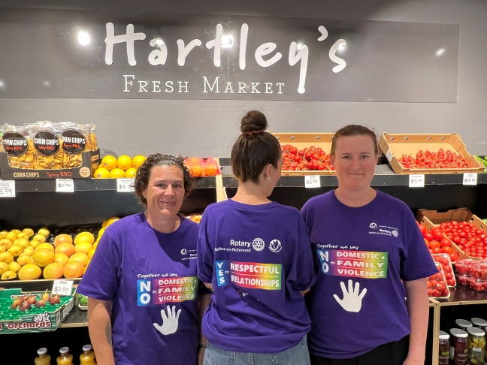
Notes:
Local businesses participating in Purple Friday

Slide 15
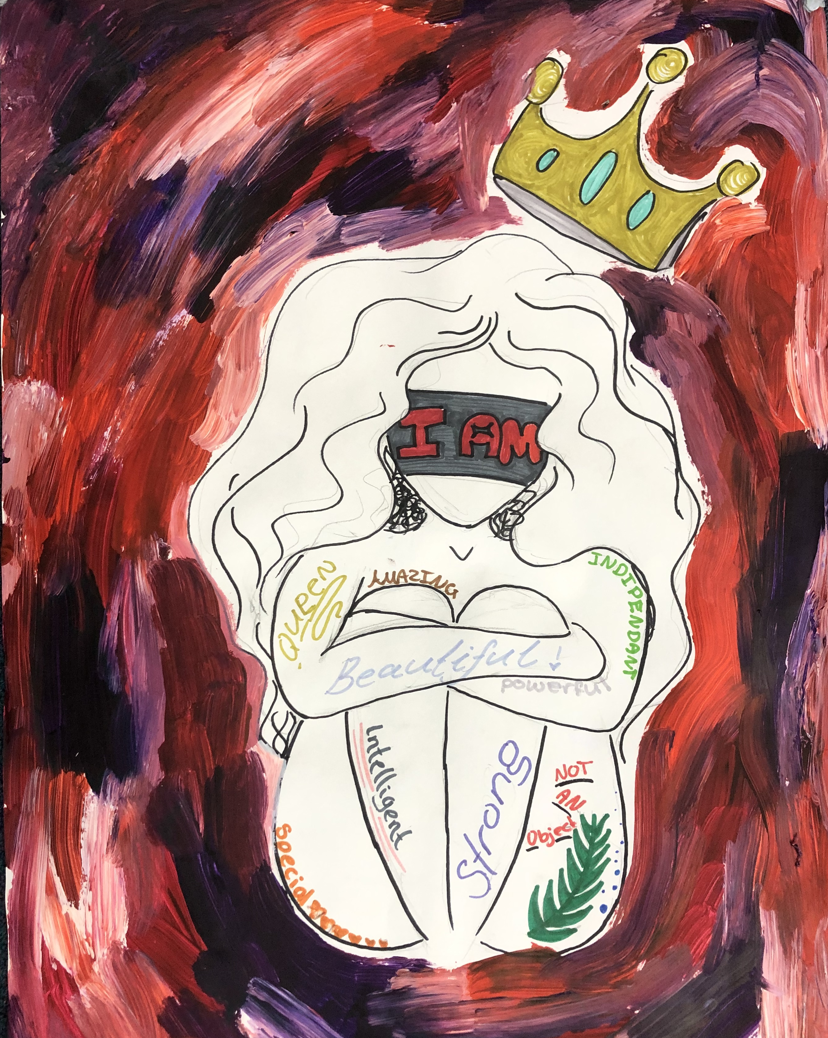
North Coast Youth Domestic Violence Strategy
Expansion of the Love Bites Program
The aim of the strategy is for 75% of high schools on the North Coast to be running the program Years 7-10 by the end of 2024
We now have a Respectful Relationships program for Years 5 & 6 in Primary Schools
Notes:
Late in 2020, the Department of Premier and Cabinet created a Youth Domestic Violence Strategy in response to the continuing and concerning prevalence of D&FV perpetrated by youth against their peers and their own families.
The Love Bites program was chosen for this strategy.
Love Bites is written from a feminist perspective, which identifies relationship violence as a gendered crime, due to the likelihood of females being victims of relationship violence.
The causes of this violence are analysed and acknowledges that multiple factors shape violence.
It is recognised that although males are far more likely to be perpetrators of relationship violence than females, the majority of males do not commit these crimes.
The Youth Domestic Violence Strategy aims for 75% of all High Schools from Bullahdelah to Tweed Heads to have Love Bites programs being delivered in their schools by the end of 2022.
This, as you can imagine, is a huge undertaking. Love Bites is delivered by trained facilitators who volunteer their time to run these programs.
NSW Police appointed a project lead, at Inspector level, for the North Coast and she set about finding the existing Love Bites Facilitators. I received an email from Kiah Bowen and agreed to set up and coordinate the Ballina/Byron Love Bites committee and later, support the Love Bites committee for Tweed heads also. I attend the Lismore committee meeting as well. I have the wonderful opportunity to undertake this role in addition to my position as an AP L&S from here to Tweed.
Love Bites is a respectful relationships program that aims to provide a safe environment in which young people can talk about D&FV and Sexual Assault.
We aim to promote and model respectful relationships for young people, to challenge gender stereotypes, attitudes, values.
Love Bites promotes a clear, consistent community approach to issues of D&FV.

Slide 16
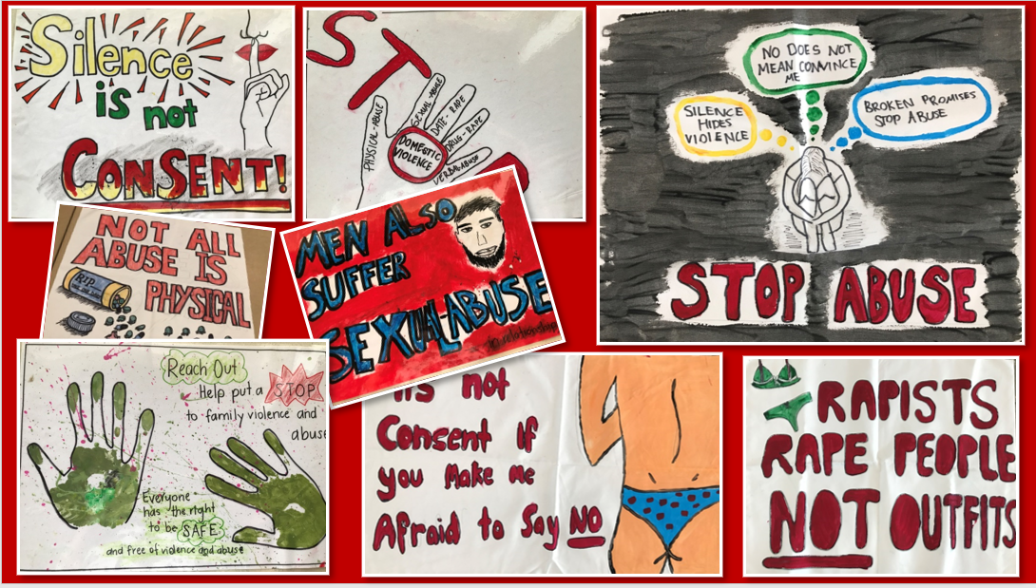
Notes:
This is some of the artwork produced by year 10 classes at Ballina Coast High School as part of the Love Bites program

Slide 17
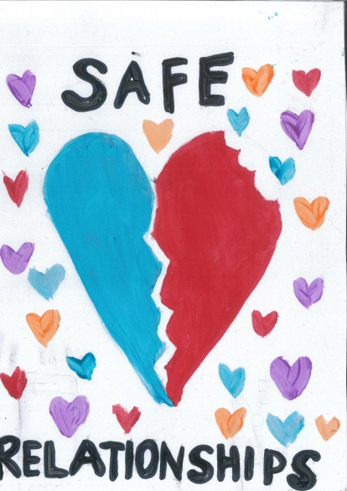
This Campaign has expanded our reach, enhanced participant engagement, and created great Impact.
We have formed partnerships and agreements with
NSW, QLD, ACT Police
Dept of Education
NAPCAN (Love Bites)
Dept of Health
Other Service Organisations and Social Service agencies
NSW & Australian Domestic and Family Violence Commissioners
Tri Partisan Federal Government
This is a Preventative Strategy and requires a whole of community approach.

Slide 18
Notes:
From 2019 to 2021 our club grew from 33 to 76 members. In June this year we had 88 members.

Slide 19
Notes:
Be brave, we can continue doing what we have always done or we can adapt and connect with what is relevant in our towns and cities. Our youth connect with causes related to the environment or social justice. Take a risk, what do you have to loose.

Slide 20
Find Identity
(Club Type + Causes + Demographics) * Relevance =
Identity

Slide 21
Stronger Together What are the possibilities and opportunities?
Rotary clubs in towns and cities connecting with and or partnering with stakeholders such as;
* Local Council
* Police
* D&FV support agencies
* Both Primary & Secondary Schools
* Licenced Clubs
Rotary clubs to help promote and support the Purple Friday campaign
Rotary clubs to support (if there is currently an activity organised by another party) and or lead an activation of a walk or other community activity during the 16 days of activism this year. The national day of action for Rotary is Friday 29th of November
Rotary clubs to support the delivery of the Love Bites Program in local schools. Help fund the training of facilitators, volunteer as facilitators, fund raising, promote the program
This Campaign aligns with and supports the federal Governments ‘Stop it at the Start’ national campaign.
State & Federal government agencies and many non-government agencies endorse and support our whole of community campaign.

Slide 22
STRONGER
TOGETHER
Join US
STOP the VIOLENCE and END the SILENCE
CHANGING
Attitudes,
Behaviours &
Lives
Notes:
Notice the 2 promotional tiles with famous female sports stars. During the 16 days of activism last year the NSW government, NSW Police and Rotary combined to have 16 different promotional tiles, one for each of the 16 days that we shared through social media. Again this is Public Image at its best

